Slide 1
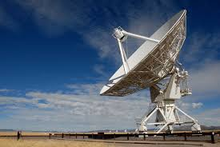
SMART ANTENNAS
Reham mahmoud
Amira aboelnasr

Slide 2
CONTENTS
INTRODUCTION
TYPES OF SMART ANTENNAS
COMPARISION BETWEEN SWITCHED BEAM AND ADAPTIVE ARRAY
ADVANTAGES AND DISADVANTAGES
APPLICATION

Slide 3
INTRODUCTION
What is SMART ANTENNA ?
A smart antenna consists of an antenna array, that changes the array pattern in response to signal environment to improve the performance of a communication system.

Slide 4
THE AIM OF SMART ANTENNA SYSTEM
To maximize the antenna gain in the desired direction.
To minimize the gain in directions of interferers.

Slide 5
TYPES OF SMART ANTENNA
SWITCHED BEAM ANTENNA
- a finite number of fixed ,predefined patterns.
ADAPTIVE ARRAYANTENNA
- an infinite number of patterns that are adjusted in real time.

Slide 7
SWITCHED BEAM ANTENNAS
This systems form multiple fixed beams with heightened sensitivity in particular directions.
When incoming signal detected it determines the beam which is best aligned based on SOI and switches to that beam to communicate with user.
As the mobile unit moves throughout the cell, the switchedbeam system detects the signal strength and continually switches the beams as necessary.

Slide 8
ADAPTIVE ARRAY ANTENNAS
Systems are really smart because they are able to dynamically react to the changing RF environment with its infinite scenario based patterns.
They can direct the main beam toward the SOI(Signal Of Interest) while suppressing the antenna pattern in the direction of the interferers.
It can customize an appropriate radiation pattern for each individual user.
Dynamically adjust the antenna pattern to enhance reception while minimizing or fully rejecting interference .

Slide 9
DOA ESTIMATION TECHNIQUE
THERE ARE FOYR METHODS
Conventional method
Subspaced method
Maximum likelihood method
Integrated method

Slide 10
MUSIC ALGORITHM
It Stands for MUltiple Signal Classification .
It is one of the high resolution subspaced DOA algorithm .
It is more simplex algorithm.

Slide 11
MUSIC deals with the decomposition of correlation matrix into two orthogonal matrices, signal-subspace and noise-subspace.
Estimation of AOA is performed from one of these subspaces .
assuming that noise in each channel is highly uncorrelated so the correlation matrix is diagonal matrix

Slide 12
The correlation matrix is given by:
Rxx= E[x.xH] = E[(As+n)(sHAH+nH)]
=A E[s.sH] AH+E[n.nH]
= A Rss AH+ Rnn
Where
Rss=DxD source correlation matrix
Rnn=MxM noise correla-tion matrix

Slide 13
The noise subspace is an M×(M- D) matrix.
The signal subspace is an M× D matrix.
The noise subspace eigenvectors are orthogonal to the array steering vectors at the angles of arrival θ1, θ2… ,θD
Because of this orthogonality condition, one can show that the Euclidean distance d2 =a(θ)H EN ENH a(θ)= 0 for each and every arrival angle θ1, θ2… ,θD

Slide 14
Placing this distance expression in the denominator creates sharp peaks at the angles of arrival.
The MUSIC pseudo spectrum is now given as

Slide 15
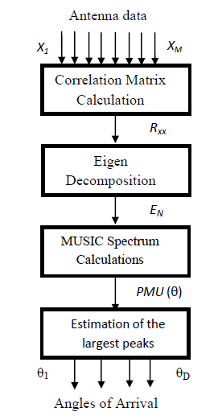
MUSIC implementation flow chart

Slide 16
ADVANTAGES OF SMART ANTENNA
Enhance coverage through Range extension.
Fully controllable by software so less manual operations.
Provides high security.
Improve system capacity.
Compatibility, it can be applied to various multiple access techniques such as TDMA,FDMA ,and CDMA.

Slide 17
Smart Antenna’s Drawbacks
Their transceivers are much more complex than traditional base station transceivers.
Expensive.

Slide 18
APPLICATION
Cellular and wireless networks
Satellite systems

